Slide 1
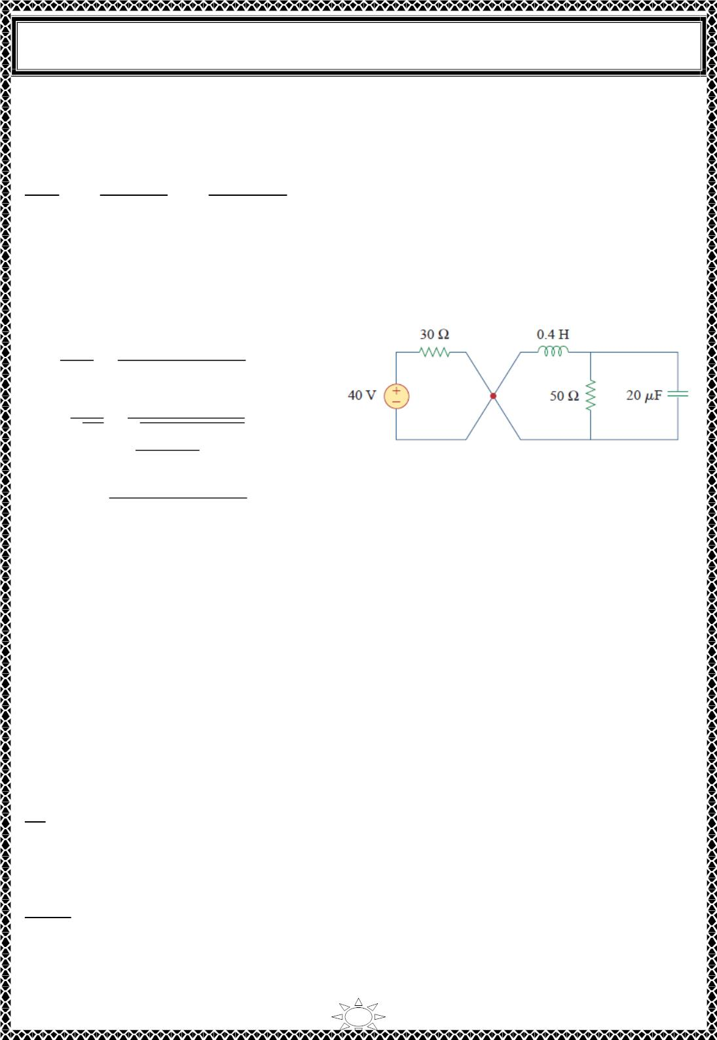
University of Diyala
Engineering College
Electrical Circuits
The direction of 푖 is as indicated in Fig.1. to conform with the direction of 퐼₀ in Fig.4.1,
which is in agreement with the convention that current flows into the positive terminal of an
inductor. We need to express this in terms of 푑푣/푑푡, since we are looking for 푣.
ꢀꢁ(0)
ꢀꢂ
= −
ꢁ(0)+푅ꢃ(0)
푅퐶
= −
25ꢄ50×0.5
= ꢆ
(2)
50×20×10^{ꢅ6}
When 푡 > ꢆ, the switch is closed. The voltage source along with the 3ꢆ − 훺 resistor is
separated ffom the rest of the circuit. The parallel RLC circuit acts independently of the
voltage source, as illustrated in Fig.2. Next, we determine that the roots of the characteristic
equation are
훼 =
ꢇ
=
ꢇ
= ꢋꢆꢆ
= 3ꢋ4
ꢈꢉꢊ ꢈ×ꢋꢆ×ꢈꢆ×ꢇꢆ^{ꢄꢌ}
휔₀ =
ꢇ
=
ꢇ
√퐿ꢊ √ꢆ4×ꢈꢆ×ꢇꢆ^{ꢄꢌ}
푠_{1,2} = −훼 ± ꢍ훼² − 휔₀²
Fig.2 The circuit in Fig.1 when t >0. The
parallel RLC circuit on the right-hand
side acts independently of the circuit on
the left-hand side of the junction.
Trail Version
Trail Version
Trail Version
Trail Version
Trail Version
Trail Version
Trail Version
Trail Version
Trail Version
Trail Version
Trail Version
Trail Version
Trail Version
= −ꢋꢆꢆ ± ꢍꢈꢋꢆ,ꢆꢆꢆ − ꢇꢈ4,997ꢎ = −ꢋꢆꢆ ± 3ꢋ4
or
푠 = −8ꢋ4, 푠 = −ꢇ4ꢎ
1
2
Since 훼 > 휔₀, we have the overdamped response
푣(푡) = 퐴 푒^{ꢄꢏ5ꢐꢂ} ꢑ 퐴 푒^{ꢄ1ꢐꢌꢂ}
(3)
1
2
At 푡 = ꢆ, we impose the condition in Eq. (1),
푣(푂) = ꢈꢋ = 퐴 ꢑ 퐴 ⇒ 퐴 = ꢈꢋ − 퐴
1
(4)
1
2
2
Taking the derivative of 푣(푡) in Eq. (3),
푑푣
= −8ꢋ4퐴 푒^{ꢄꢏ5ꢐꢂ} − ꢇ4ꢎ퐴 푒^{ꢄ1ꢐꢌꢂ}
푑푡
1
2
Imposing the condition in Eq. (2),
푑푣(ꢆ)
= ꢆ = −8ꢋ4퐴₁ − ꢇ4ꢎ퐴₂
푑푡
or
22

Slide 2
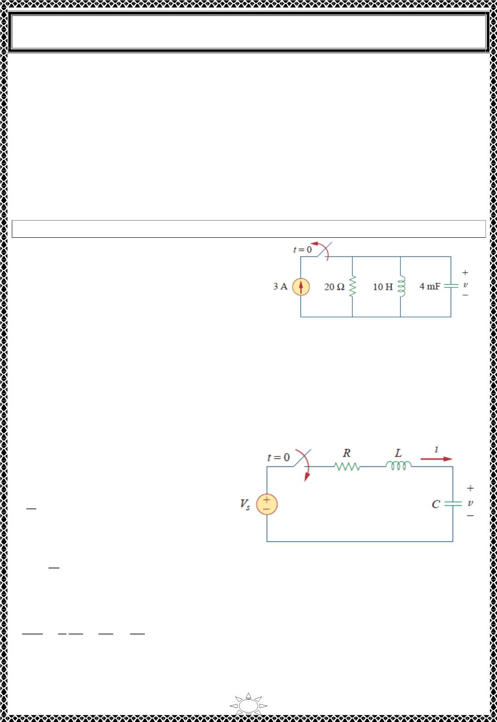
University of Diyala
Engineering College
Electrical Circuits
0 = 854퐴₁ + ꢀ46퐴₂
(5)
Solving Eqs. (4) and (5) gives
퐴 = −5.ꢀ56, 퐴 = 30.ꢀ6
1
2
Thus, the complete solution in Eq. (3) becomes
푣(푡) = −5.ꢀ56푒^{ꢁꢂꢃꢄꢅ} + 30.ꢀ6푒^{ꢁ1ꢄꢆꢅ}푉
H.W. 6: Refer to the circuit in Fig.1. Find 푣(푡) for 푡 > 0.
Answer: ퟏퟎퟎ(풆^{ꢁퟏퟎ풕 − 풆ꢁퟐ.ퟓ풕)푽.}
Trail Version
Trail Version
Trail Version
Trail Version
Trail Version
Trail Version
Trail Version
Trail Version
Trail Version
Trail Version
Trail Version
Trail Version
Trail Version
Fig.1
5) Step Response of a Series RLC Circuit
Consider the series RLC circuit shown in
Fig.5.1. Applying KVL around the loop
for 푡 > 0,
푑푖
퐿 + 푅ꢇ + 푣 = 푉
(5.1)
푑ꢅ
푠
But
푑ꢈ
푑ꢅ
ꢇ = 퐶
Fig.5.1Step voltage applied to a series RLC circuit
Substituting for ꢇ in Eq. (8.39) and rearranging terms,
ꢉ²푣 푅 ꢉ푣
+
푣
푉
푠
+
=
(5.2)
ꢉ푡² 퐿 ꢉ푡 퐿퐶 퐿퐶
which has the same form as Eq. (3.3). More specifically, the coefficients are the same (and
that is important in determining the frequency parameters) but the variable is different.
23

Slide 3

University of Diyala
Engineering College
Electrical Circuits
(Likewise, see Eq. (5.9).) Hence, the characteristic equation for the series RLC circuit is not
affected by the presence of the dc source.
The solution to Eq. (5.2) has two components: the transient response 푣_{푡}(ꢀ) and the steady‐
state response 푣_{푠푠}(ꢀ) ; that is,
푣(ꢀ) = 푣 (ꢀ) + 푣 (ꢀ)
(5.3)
푡
푠푠
The transient response 푣_{푡}(ꢀ) is the component of the total response that dies out with time.
The form of the transient response is the same as the form of the solution obtained in Section
3 for the source‐free circuit, given by Eqs. (3.13), (3.20), and (3.25). Therefore, the transient
repsonse 푣_{푡}(ꢀ) for the overdamped, underdamped, and critically damped cases are:
푣 (ꢀ) = 퐴 푒^{푠 푡} + 퐴 푒^{푠 푡}
(Overdamped)
푡
1
ꢁ
2
ꢂ
(5.4a)
(5.4b)
(5.4c)
푣 (ꢀ) = (퐴 + 퐴 ꢀ)푒−훼푡
(Critically damped)
(Underdamped)
푡
1
2
푣 (ꢀ) = (퐴 cos 휔 ꢀ + 퐴 sin 휔 ꢀ)푒−훼푡
푡
1
푑
2
푑
The steady‐state response is the final value of 푣(ꢀ) . In the circuit in Fig.5.1, the final value
of the capacitor voltage is the same as the source voltage 푉_{푠}. Hence,
Trail Version
Trail Version
Trail Version
Trail Version
Trail Version
Trail Version
Trail Version
Trail Version
Trail Version
Trail Version
Trail Version
Trail Version
Trail Version
푣_{푠푠}(ꢀ) = 푣(∞) = 푉
(5.5)
푠
Thus, the complete solutions for the overdamped, underdamped, and critically damped cases
are:
푣(ꢀ) = 푉 + 퐴 푒^{푠 푡} + 퐴 푒^{푠 푡}
(Overdamped)
푠
1
ꢁ
2
ꢂ
(5.6a)
(5.6b)
(5.6c)
푣(ꢀ) = 푉 + (퐴 + 퐴 ꢀ)푒−훼푡
(Critically damped)
(Underdamped)
푠
1
2
푣(ꢀ) = 푉 + (퐴 cos 휔 ꢀ + 퐴 sin 휔 ꢀ)푒−훼푡
푠
1
푑
2
푑
The values of the constants 퐴 and 퐴 are obtained from the initial conditions: 푣(푂) and
1
2
ꢃ푣(푂)/ꢃꢀ. Keep in mind that 푣 and 푖 are, respectively, the voltage across the capacitor and
the current through the inductor. Therefore, Eq. (5.6) only applies for finding 푣. But once
the capacitor voltage 푣_{퐶} = 푣 is known, we can determine 푖 = ꢄꢃ푣/ꢃꢀ, which is the same
current through the capacitor, inductor, and resistor. Hence, the voltage across the resistor
is 푣 = 푖ꢅ, while the inductor voltage is 푣 = ꢆꢃ푖/ꢃꢀ.
푅
퐿
Alternatively, the complete response for any variable 푥(ꢀ) can be found directly, because it
has the general form
푥(ꢀ) = 푥 (ꢀ) + 푥 (ꢀ)
(5.7)
푠푠
푡
24

Slide 4
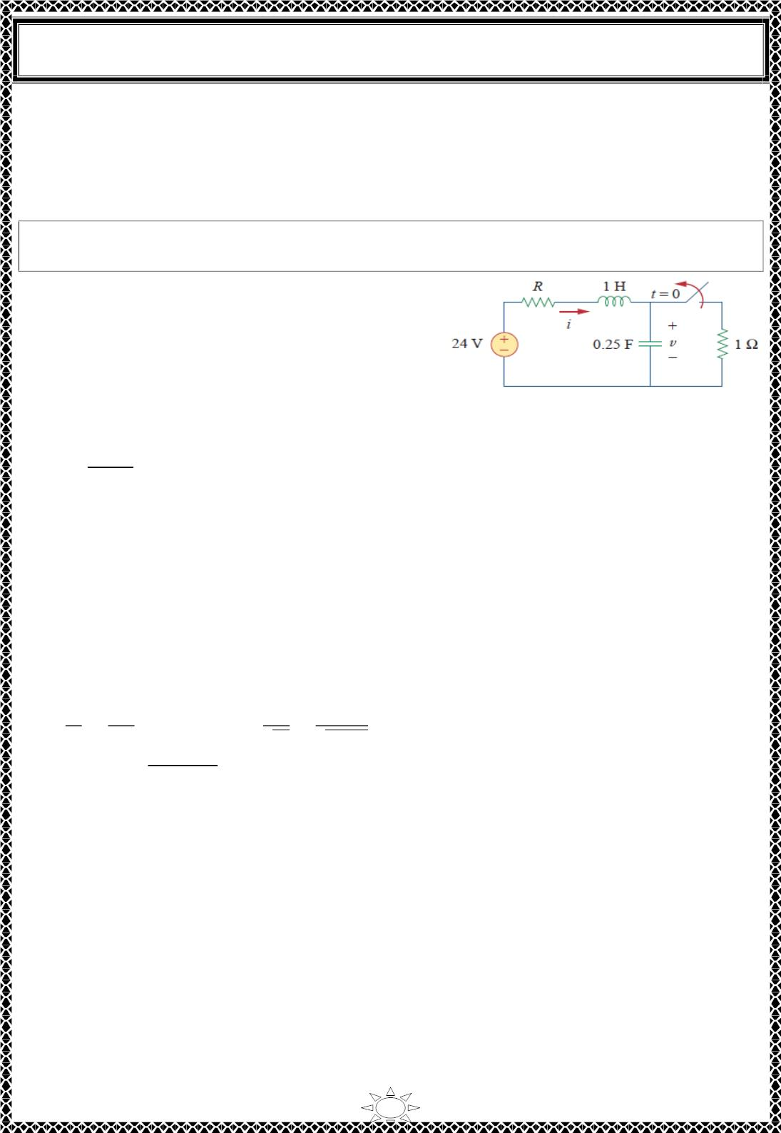
University of Diyala
Engineering College
Electrical Circuits
where the 푥 = 푥(∞) is the final value and 푥 (ꢀ) is the transient response. The final value
푠푠
푡
is found as in Section 8.2. The transient response has the same form as in Eq. (5.4), and the
associated constants are deter‐ mined from Eq. (5.6) based on the values of 푥(푂) and
푑푥(푂)/푑ꢀ.
Example 7: For the circuit in Fig. 1, find 푣(ꢀ) and 푖(ꢀ) for ꢀ > 0. Consider these cases:
푅 = 5훺, 푅 = 4훺, and 푅 = 1훺
Solution:
CASE 1 When 푅 = 5훺. For ꢀ < 0, the switch is
closed for a long time. The capacitor behaves like
an open circuit while the inductor acts like a short
circuit. The initial current through the Figure 8.19
inductor is
Fig. 1
푖(0) =
24
= 4퐴
5 + 1
and the initial voltage across the capacitor is the same as the voltage across the 1 − 훺
resistor; that is,
Trail Version
Trail Version
Trail Version
Trail Version
Trail Version
Trail Version
Trail Version
Trail Version
Trail Version
Trail Version
Trail Version
Trail Version
Trail Version
푣(푂) = 1푖(푂) = 4푉
For ꢀ > 0, the switch is opened, so that we have the 1 − 훺 resistor disconnected. What
remains is the series RLC circuit with the voltage source. The characteristic roots are
determined as follows:
ꢁ
ꢃ
ꢄ
ꢄ
훼 =
=
= 2.5, 휔_{ꢅ} =
=
= 2
ꢂ퐿
ꢂ×ꢄ
√퐿퐶
√ꢄ×ꢅꢂꢃ
ꢆ_{ꢄ,ꢂ} = −훼 ± ꢇ훼^{ꢂ} − 휔_{ꢅ}^{ꢂ} = −1, −4
Since 훼 > 휔_{ꢅ}, we have the overdamped natural response. The total response is therefore
푣(ꢀ) = 푣 + (퐴 푒^{ꢈ푡} + 퐴 푒^{ꢈꢉ푡})
푠푠
ꢄ
ꢂ
where 푣_{푠푠} is the steady‐state response. It is the final value of the capacitor voltage. In Fig.
1, 푣_{푓} = 24 V. Thus,
푣(ꢀ) = 24 + (퐴 푒^{ꢈ푡} + 퐴 푒^{ꢈꢉ푡})
(1)
ꢄ
ꢂ
We now need to find 퐴 and 퐴 using the initial conditions.
ꢄ
ꢂ
푣(0) = 4 = 24 + 퐴_{ꢄ} + 퐴_{ꢂ}
25

Slide 5

University of Diyala
Engineering College
Electrical Circuits
or
−20 = 퐴₁ + 퐴ꢀ
(2)
The current through the inductor cannot change abruptly and is the same current through the
capacitor at 푡 = 0ꢁ because the inductor and capacitor are now in series. Hence,
푖(0) = 퐶
푑푣(0)
푑푡
= 4 ⇒
푑푣(0)
푑푡
4
퐶
4
=
=
= ꢂ6
0.25
Before we use this condition, we need to take the derivative of 푣 in Eq. (1).
푑푣
= −퐴 푒^{ꢃꢄ} − 4퐴 푒^{ꢃꢅꢄ}
(3)
(4)
푑푡
1
ꢀ
At 푡 = 0,
푑푣(0)
Trail Version
Trail Version
Trail Version
Trail Version
Trail Version
Trail Version
Trail Version
Trail Version
Trail Version
Trail Version
Trail Version
Trail Version
Trail Version
푑푡
= ꢂ6 = −퐴₁ − 4퐴ꢀ
From Eqs. (2) and (4), 퐴 = −64/3 and 퐴 = 4/3. Substituting 퐴 and 퐴 in Eq. (1), we
get
1
ꢀ
1
ꢀ
4
푣(푡) = 24 + (−ꢂ6푒^{ꢃꢄ} + 푒^{ꢃꢅꢄ})푉
(5)
3
Since the inductor and capacitor are in series for 푡 > 0, the inductor current is the same as
the capacitor current. Hence,
푑푣
푖(푡) = 퐶
푑푡
Multiplying Eq. (3) by 퐶 = 0.25 and substituting the values of 퐴 and 퐴 gives
1
ꢀ
ꢅ
푖(푡) = (4푒^{ꢃꢄ} − 푒^{ꢃꢅꢄ})퐴
(6)
ꢆ
Note that 푖(푂) = 4퐴, as expected.
CASE 2 When 푅 = 4훺. Again, the initial current through the inductor is
푖(0) =
24
= 4.8퐴
4 + ꢂ
26

Slide 6

University of Diyala
Engineering College
Electrical Circuits
and the initial capacitor voltage is
푣(푂) = 1푖(푂) = 4.8푉
For the characteristic roots,
훼 =
푅
=
4
= 2
2퐿 2×1
while 휔 = 2 remains the same. In this case, 푠 = 푠 = −훼 = −2, and we have the
0
ꢀ
ꢁ
critically damped natural response. The total response is therefore
푣(푡) = 푣 + (퐴 + 퐴 푡)푒^{ꢃꢁꢄ}
ꢂꢂ
ꢀ
ꢁ
and, as before 푣_{ꢂꢂ} = 24푉,
푣(푡) = 24 + (퐴 + 퐴 푡)푒^{ꢃꢁꢄ}
(7)
(8)
ꢀ
ꢁ
To find 퐴 and 퐴 , we use the initial conditions. We write
ꢀ
ꢁ
푣(푂) = 4.8 = 24 + 퐴 ⇒ 퐴 = −19.2
ꢀ
ꢀ
Trail Version
Trail Version
Trail Version
Trail Version
Trail Version
Trail Version
Trail Version
Trail Version
Trail Version
Trail Version
Trail Version
Trail Version
Trail Version
Since 푖(푂) = 퐶푑푣(푂)/푑푡 = 4.8
or
푑푣(ꢅ) 4.8
푑푡
=
퐶
= 19.2
From Eq. (7),
ꢆꢇ
= (−2퐴 − 2푡퐴 + 퐴 )푒^{ꢃꢁꢄ}
(9)
ꢆꢄ
ꢀ
ꢁ
ꢁ
At 푡 = ꢅ,
ꢆꢇ(0)
= 19.2 = −2퐴ꢀ + 퐴ꢁ
(10)
(11)
ꢆꢄ
From Eqs. (8) and (10), 퐴 = −19.2 and 퐴 = −19.2. Thus, Eq. (7) becomes
ꢀ
ꢁ
푣(푡) = 24 − 19.2(1 + 푡)푒^{ꢃꢁꢄ}푉
The inductor current is the same as the capacitor current; that is,
푑푣
푖(푡) = 퐶
푑푡
Multiplying Eq. (9) by 퐶 = ꢅ.25 and substituting the values of 퐴 and 퐴 gives
ꢀ
ꢁ
푖(푡) = (4.8 + 9.6푡)푒^{ꢃꢁꢄ}퐴
(12)
Note that 푖(푂) = 4.8퐴, as expected.
27

Slide 7

University of Diyala
Engineering College
Electrical Circuits
CASE 3 When 푅 = 1훺. The initial inductor current is
푖(0) =
24
= 12퐴
1 + 1
and the initial voltage across the capacitor is the same as the voltage across the 1 − 훺
resistor,
푣(푂) = 1푖(푂) = 12푉
훼 =
푅
=
1
= 0.5
2퐿 2×1
Since 훼 = 0.5 < 휔ꢀ = 2, we have the underdamped response
푠_{ꢁ,ꢂ} = −훼 ± √훼^{ꢂ} − 휔ꢀ^{ꢂ} = −0.5 ± 푗1.936
Trail Version
Trail Version
Trail Version
Trail Version
Trail Version
Trail Version
Trail Version
Trail Version
Trail Version
Trail Version
Trail Version
Trail Version
Trail Version
The total response is therefore
푣(푡) = 24 + (퐴 cos 1.936푡 + 퐴 sin 1.936푡)푒^{ꢃꢀ.ꢄꢅ}
(13)
(14)
ꢁ
ꢂ
We now determine 퐴 and 퐴 . We write
ꢁ
ꢂ
푣(푂) = 12 = 24 + 퐴 ⇒ 퐴 = −12
ꢁ
ꢁ
Since 푖(푂) = 퐶푑푣(푂)/푑푡 = 12,
ꢆꢇ(ꢀ)
ꢆꢅ
But
ꢁꢂ
ꢈ
=
= 48
(15)
(16)
푑푣
푑푡
= 푒^{ꢃꢀ.ꢄꢅ}(−1.936퐴 sin 1.936푡 + 1.936퐴 cos 1.936푡)
ꢁ
ꢂ
−0.5푒^{ꢃꢀ.ꢄꢅ}(퐴 cos 1.936푡 + 퐴 sin 1.936푡)
At 푡 = 0,
ꢁ
ꢂ
푑푣(0)
= 48 = (−0 + 1.936퐴 ) − 0.5(퐴 + 0)
푑푡
ꢂ
ꢁ
Substituting 퐴 = −12 gives 퐴 = 21.694, and Eq. (13) becomes
ꢁ
ꢂ
푣(푡) = 24 + (21.694 sin 1.936푡 − 12 cos 1.936푡)푒^{ꢃꢀ.ꢄꢅ}푉
(17)
The inductor current is
28

Slide 8
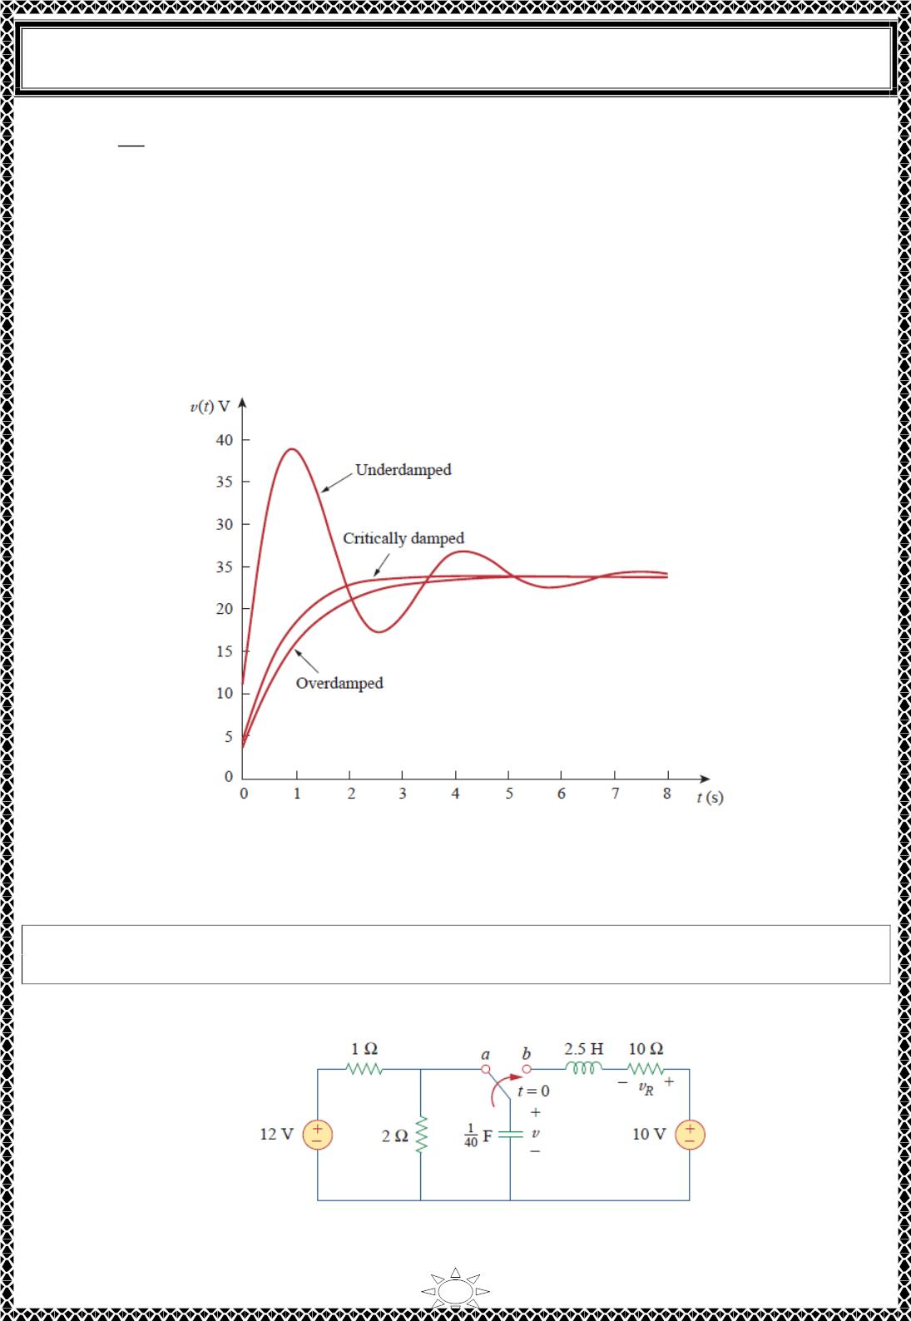
University of Diyala
Engineering College
Electrical Circuits
푑푣
푖(푡) = 퐶
푑푡
Multiplying Eq. (16) by 퐶 = 0.25 and substituting the values of 퐴 and 퐴 gives
1
ꢀ
푖(푡) = (3.ꢁ sin ꢁ.936푡 + ꢁ2 cos ꢁ.936푡)푒^{−ꢂ.ꢃꢄ}퐴
(18)
Note that 푖(푂) = ꢁ2퐴, as expected.
Fig.2 plots the responses for the three cases. From this figure, we observe that the critically
damped response approaches the step input of 24 푉 the fastest.
Trail Version
Trail Version
Trail Version
Trail Version
Trail Version
Trail Version
Trail Version
Trail Version
Trail Version
Trail Version
Trail Version
Trail Version
Trail Version
Fig.2 response for three degrees of damping.
H.W. 7: Having been in position 푎 for a long time, the switch in Fig.1 is moved to position
푏 at 푡 = 0. Find 푣(푡) and 푣_{푅}(푡) for 푡 > 0.
Answer: 10—(ퟏ. ퟏퟓퟒퟕ 퐬퐢퐧 ퟑ. ퟒퟔퟒ풕 + ퟐ 퐜퐨퐬 ퟑ. ퟒퟔퟒ풕)풆^{−ퟐ풕푽,} 2.
ퟑퟏ풆^{−ퟐ풕} 퐬퐢퐧 ퟑ. ퟒퟔퟒ풕푽.
29

Slide 9
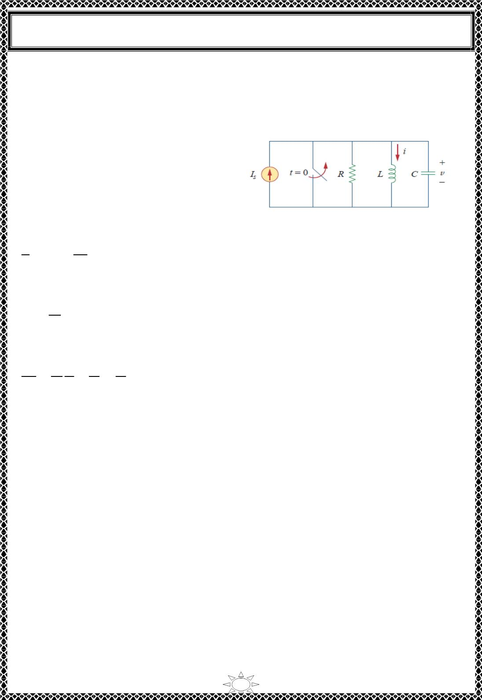
University of Diyala
Engineering College
Electrical Circuits
Fig.1
6) Step Response of a Parallel RLC Circuit
Consider the parallel RLC circuit shown in
Fig.6.1. We want to find 푖 due to a sudden
application of a dc current. Applying KCL
at the top node for 푡 > 0,
Fig.6.1 Parallel RLC circuit with an applied current.
푣
푑푣
푑푡
+ 푖 + 퐶
= 퐼_{푠}
(6.1)
푅
But
푑푖
푑푡
푣 = 퐿
Trail Version
Trail Version
Trail Version
Trail Version
Trail Version
Trail Version
Trail Version
Trail Version
Trail Version
Trail Version
Trail Version
Trail Version
Trail Version
Substituting for 푣 in Eq. (6.1) and dividing by 퐿퐶, we get
2
ꢀ ꢁ
ꢀꢂ²
+
1 ꢀꢁ
ꢁ
^{ꢆ}ꢇ
ꢅꢄ
(6.2)
ꢃꢄ ꢀꢂ
+
=
ꢅꢄ
which has the same characteristic equation as Eq. (4.3).
The complete solution to Eq. (6.2) consists of the transient response 푖_{ꢂ}(푡) and the steady‐
state response 푖_{푠푠}; that is,
푖(푡) = 푖 (푡) + 푖 (푡)
(6.3)
ꢂ
푠푠
The transient response is the same as what we had in Section 4. The steady‐state response
is the final value of 푖. In the circuit in Fig.6.1, the final value of the current through the
inductor is the same as the source current 퐼_{푠}. Thus,
푖(푡) = 퐼 + 퐴 푒^{푠 ꢂ} + 퐴 푒^{푠 ꢂ}
(Overdamped)
푠
1
ꢈ
ꢉ
2
(6.4a)
(6.4b)
(6.4c)
푖(푡) = 퐼 + (퐴 + 퐴 푡)푒−훼ꢂ
(Critically damped)
(Underdamped)
푠
1
ꢉ
푖(푡) = 퐼 + (퐴 cos 휔 푡 + 퐴 sin 휔 푡)푒−훼ꢂ
푠
1
ꢀ
ꢉ
ꢀ
The constants 퐴 and 퐴 in each case can be determined from the initial conditions for 푖 and
1
ꢉ
푑푖/푑푡. Again, we should keep in mind that Eq. (6.4) only applies for finding the inductor
current 푖. But once the inductor current 푖_{ꢅ} = 푖 is known, we can find 푣 = 퐿푑푖/푑푡, which is
the same voltage across inductor, capacitor, and resistor. Hence, the current through the
30

Slide 10
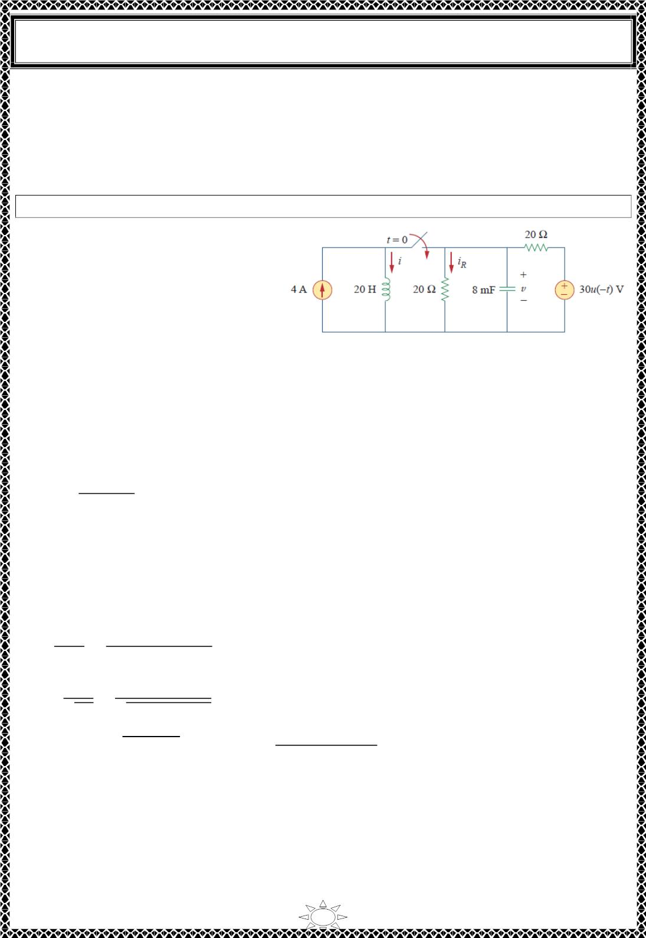
University of Diyala
Engineering College
Electrical Circuits
resistor is 푖 = 푣/ꢀ, while the capacitor current is 푖 = ꢁ푑푣/푑푡. Alternatively, the complete
푅
퐶
response for any variable 푥(푡) may be found directly, using
푥(푡) = 푥 (푡) + 푥 (푡)
(6.5)
푠푠
ꢂ
where 푥 and 푥 are its final value and transient response, respectively.
푠푠
ꢂ
Example 8: In the circuit of Fig.1, find 푖(푡) and 푖_{푅}(푡) for 푡 > 0.
Solution:
For 푡 < 0, the switch is open, and the
circuit is partitioned into two inde‐
pendent subcircuits. The 4‐퐴 current
flows through the inductor, so that
푖(0) = 4퐴
Fig.1
Since 30푢(−푡) = 30 when 푡 < 0 and 0 when 푡 > 0, the voltage source is operative for 푡 <
0. The capacitor acts like an open circuit and the voltage across it is the same as the voltage
across the 20 − 훺 resistor connected in parallel with it. By voltage division, the initial
capacitor voltage is
Trail Version
Trail Version
Trail Version
Trail Version
Trail Version
Trail Version
Trail Version
Trail Version
Trail Version
Trail Version
Trail Version
Trail Version
Trail Version
푣(푂) =
20
(30) = 15푉
20 + 20
For 푡 > 0, the switch is closed, and we have a parallel RLC circuit with a current source.
The voltage source is zero which means it acts like a short‐circuit. The two 20 − 훺 resistors
are now in parallel. They are combined to give ꢀ = 20‖20 = 10훺. The characteristic roots
are determined as follows:
훼 =
1
=
1
= 6.25
= 2.5
2ꢀꢁ 2×10×8×10^{ꢃꢄ}
휔_{ꢅ} =
1
=
1
√퐿ꢁ √20×8×10^{ꢃꢄ}
ꢆ_{ꢇ,ꢈ} = −훼 ± ꢉ훼^{ꢈ} − 휔_{ꢅ}^{ꢈ} = −6.25 ± √390625 − 625 = −6.25 ± 5.7282
or
ꢆ = −11.978, ꢆ = −0.5218
ꢇ
ꢈ
Since 훼 > 휔_{ꢅ}, we have the overdamped case. Hence,
31

